Slide 1



EMU-TIONAL
MENTAL HEALTH SUPPORT SYSTEM

Slide 2

INTRODUCTION
PROBLEM STATEMENT
Fostering mental health and emotional support
PROJECT BRIEF
We have built a chatbot to cater immediate needs of people who struggle with mental health and have no one to cater this need.
We provide immediate counsellors and therapists on video call

Slide 3


WHY IT'S IMPORTANT TO TALK ABOUT MENTAL HEALTH IN THE WORKPLACE
Opening up about your mental health will help you to show how you really feel, improve your relationships, and overcome challenges in every aspect of your life.

Slide 4






PROJECT OBJECTIVES
IMMEDIATE EMOTIONAL SUPPORT
SYMPTOM TRACKING AND MONITORING
SOURCE TO PROFESSIONAL HELP
CRISIS MANAGEMENT

Slide 5


FEATURES AND FUNCTIONALITIES
01
02
03
04
05
Text to speech for
Specially abled.
Ensures the confidentiality and privacy of user
connections with therapists, counsellors
Immediate support
Personalized chat sessions

Slide 6

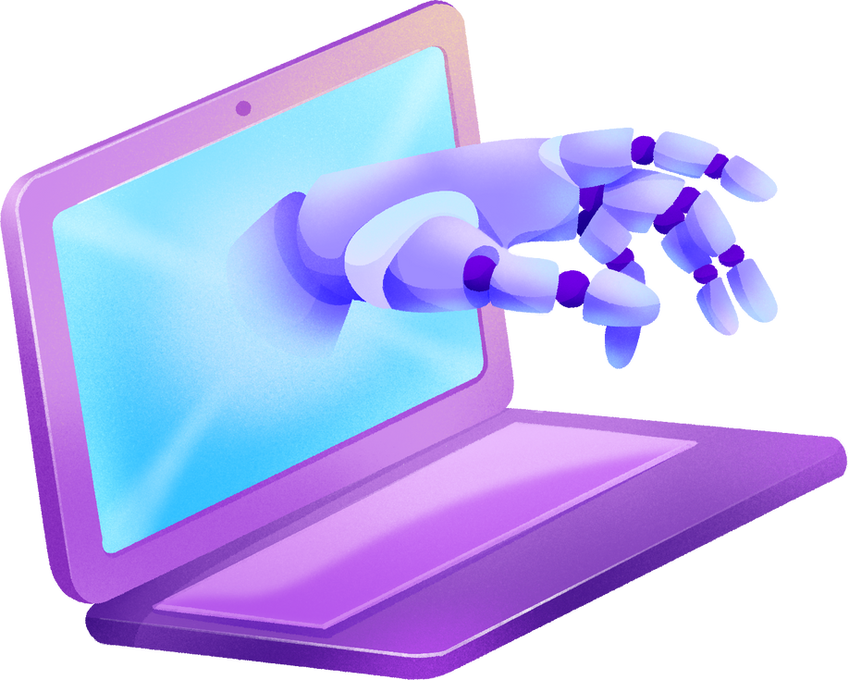

TECH STACK
HTML
CSS
(BOOTSTRAP)
JAVASCRIPT
PYTHON
(FLASK)
MySQL
GEMINI API
ZEGO CLOUD API

Slide 7
DFD AND WORKING
01
02
03
04
05
Account details added to DB,
Making login possible
Each chat session learns about the user,
Adds to DB
Learns user’s problem from DB and gives a personalized response
Allows to connect with real therapists
User signs up
using a username and password

Slide 8
BUSINESS MODEL CANVAS
Healthcare
Education
Mental Health Professionals
Employee Firms
Platform Dev
Content creation
Marketing outreach
Partnership Building
24/7 Access to Immediate Emotional Support
Personalized and Tailored Guidance
Confidential and Non-Judgmental Environment
Educational and Awareness Building
Self-service
Personalisized Support
Community Building
Continuous Enhancement
General Public
Students
Working Professionals
Healthcare Orgs
Key Partners
Key Activities
Value Propositions
Customer Relationship
Customer Segments
AI Tech
Content Library
Professional Network
Website
Mobile App
Social Media
Partnerships
Key Resources
Channels
Tech dev & maintenance
Content creation & licensing
Marketing & promotion
Partnership management
Operational costs
Subscription Model
Free Model
Partnerships
Affiliation
Cost Structure
Revenue Stream

Slide 9

FUTURE PLANS
1
2
3
4
Chatbot Advancement
New Services and Features
Integration with Healthcare Providers
Peer Support Network
5
6
7
R&D on Mental Health
Mental Health Enhancing Activities
Launch

Slide 10
DEMO

Slide 11


THANK YOU!

